Slide 1

Physics Laboratory
[PHP1010]
Academic Year 2025-26
B. Tech. Ist Year (Semester-II)
Department of Physics
Indian Institute of Technology Jodhpur

Slide 2
Schedule & Instructors
 | Mon |  | TUE |  | WED |  | THU |  | FRI
9:00 AM to 11:00 AM (1) | AD | AM | DK | SS
11:00 AM to 1:00 PM (2) | BM | DM | LP | MS |  |  | NKT | PJ | SKV | SRV
Instructors
Name | Name Code
Ambesh Dixit | AD
Sagar Kumar Verma | SKV
Naveen Kumar Tailor | NKT
B M Krishna Mariserla | BM
Monika Sinha | MS
Sampat Raj Vadera | SRV
Prabhat Jaiswal | PJ
Amit Mukherjee | AM
Dushyant Kumar | DK
Satyajit Sahu | SS
Lata Panwar | LP
Durgamadhab Mishra | DM
Student Groups
Day
 | Student Group
Monday (1) | 5th Batch (G: A5)
Monday (2) | 2nd Batch (G: A2)
Tuesday (1) | 6th Batch (G: A6)
Tuesday (2) | 3rd Batch (G: A3)
Thursday | 4th Batch (G: A4)
Friday | 1st Batch (G:A1)

Slide 3
List of TAs as per the assigned slots
Monday | 9:00AM-11:00AM
5th Batch (G: A5)
List of TA’s
P23PH0011 | Sanjeeva Rao Prattipati
P24PH0004 | Khagendra Sharma
P22PH006 | Priyanka Saini
P22PH003 | Krishnendu Karmakar
P22PH202 | Sunil Batesar
P23PH0021 | Jeevan Ram
P24PH0008 | Rashmi Trivedi
P24PH0010 | Sourav Maity
P25PH0011 | Rahul Singh Chauhan
Monday | 11:00AM-1:00PM
2nd Batch (G: A2)
List of TA’s
P25PH0017 | Smritikana Patra
P22PH004 | Minakshi
P25PH0003 | Gourav Malhotra
P23PH0008 | Prisha
P25PH0018 | Subhransu Dey
P25PH0010 | Priya Bishnoi
P25PH0015 | Saloni Sarda
P25PH0008 | Pooja Sain
P22PH008 | Sourav Dutta
Tuesday | 9:00AM-11:00AM
6th Batch (G: A6)
List of TA’s
P24PH0012 | Tushar
P23PH0016 | Verma Bunty Sardar
P25PH0012 | Rakhi
P25PH0013 | Rishika Kundel
P25PH0016 | Shahbaz Ahmad
P24PH0013 | Yogendra Singh
P23PH0012 | Snehita Ghosh
P23PH0022 | Kishan Kumar
P25PH0019 | Yogita
Tuesday | 11:00AM -1:00PM
3rd Batch (G: A3)
List of TA’s
P25PH0004 | Hrudayananda Mohanta
P24PH0002 | Akash Kumar Meel
P25PH0014 | Sachina
P23PH0003 | Basabdatta Pati
P23PH0002 | Athira S
P23PH0014 | Sonali Sahoo
P25PH0007 | Nitish Kumar
P23PH0010 | Rishabh Raj Upadhyay
P23PH0018 | Yogeesh N
Thursday | 11:00AM-1:00PM
4th Batch (G: A4)
List of TA’s
P23PH0024 | Akshika Mishra
P22PH009 | Suresh Kumar
P24PH0202 | Saurav Tyagi
P25PH0005 | Mahendra Sinwar
P24PH0011 | Tanvi Shamnath Bandkar
P24PH0003 | Kanhaiya Lal Sikhwal
P25PH0009 | Prashant Chitranshi
P25PH0006 | Manisha Kumari Meena
P23PH0005 | Gourav
Friday | 11:00AM -1:00PM
1st Batch (G:A1)
List of TA’s
P23PH0006 | Kartika Karal
P24PH0201 | Krishna Kumar Godara
P23PH0007 | Pradipta Guha Roy
P24PH0007 | Prakashkumar Shankarbhai Jepar
P25PH0001 | Antara Patra
P24PH0006 | Pallvi Pandey
P25PH0002 | Avaneesh Pandey
P24PH0001 | Aashish Joshi
P23PH0009 | Rashmi Kandari

Slide 4
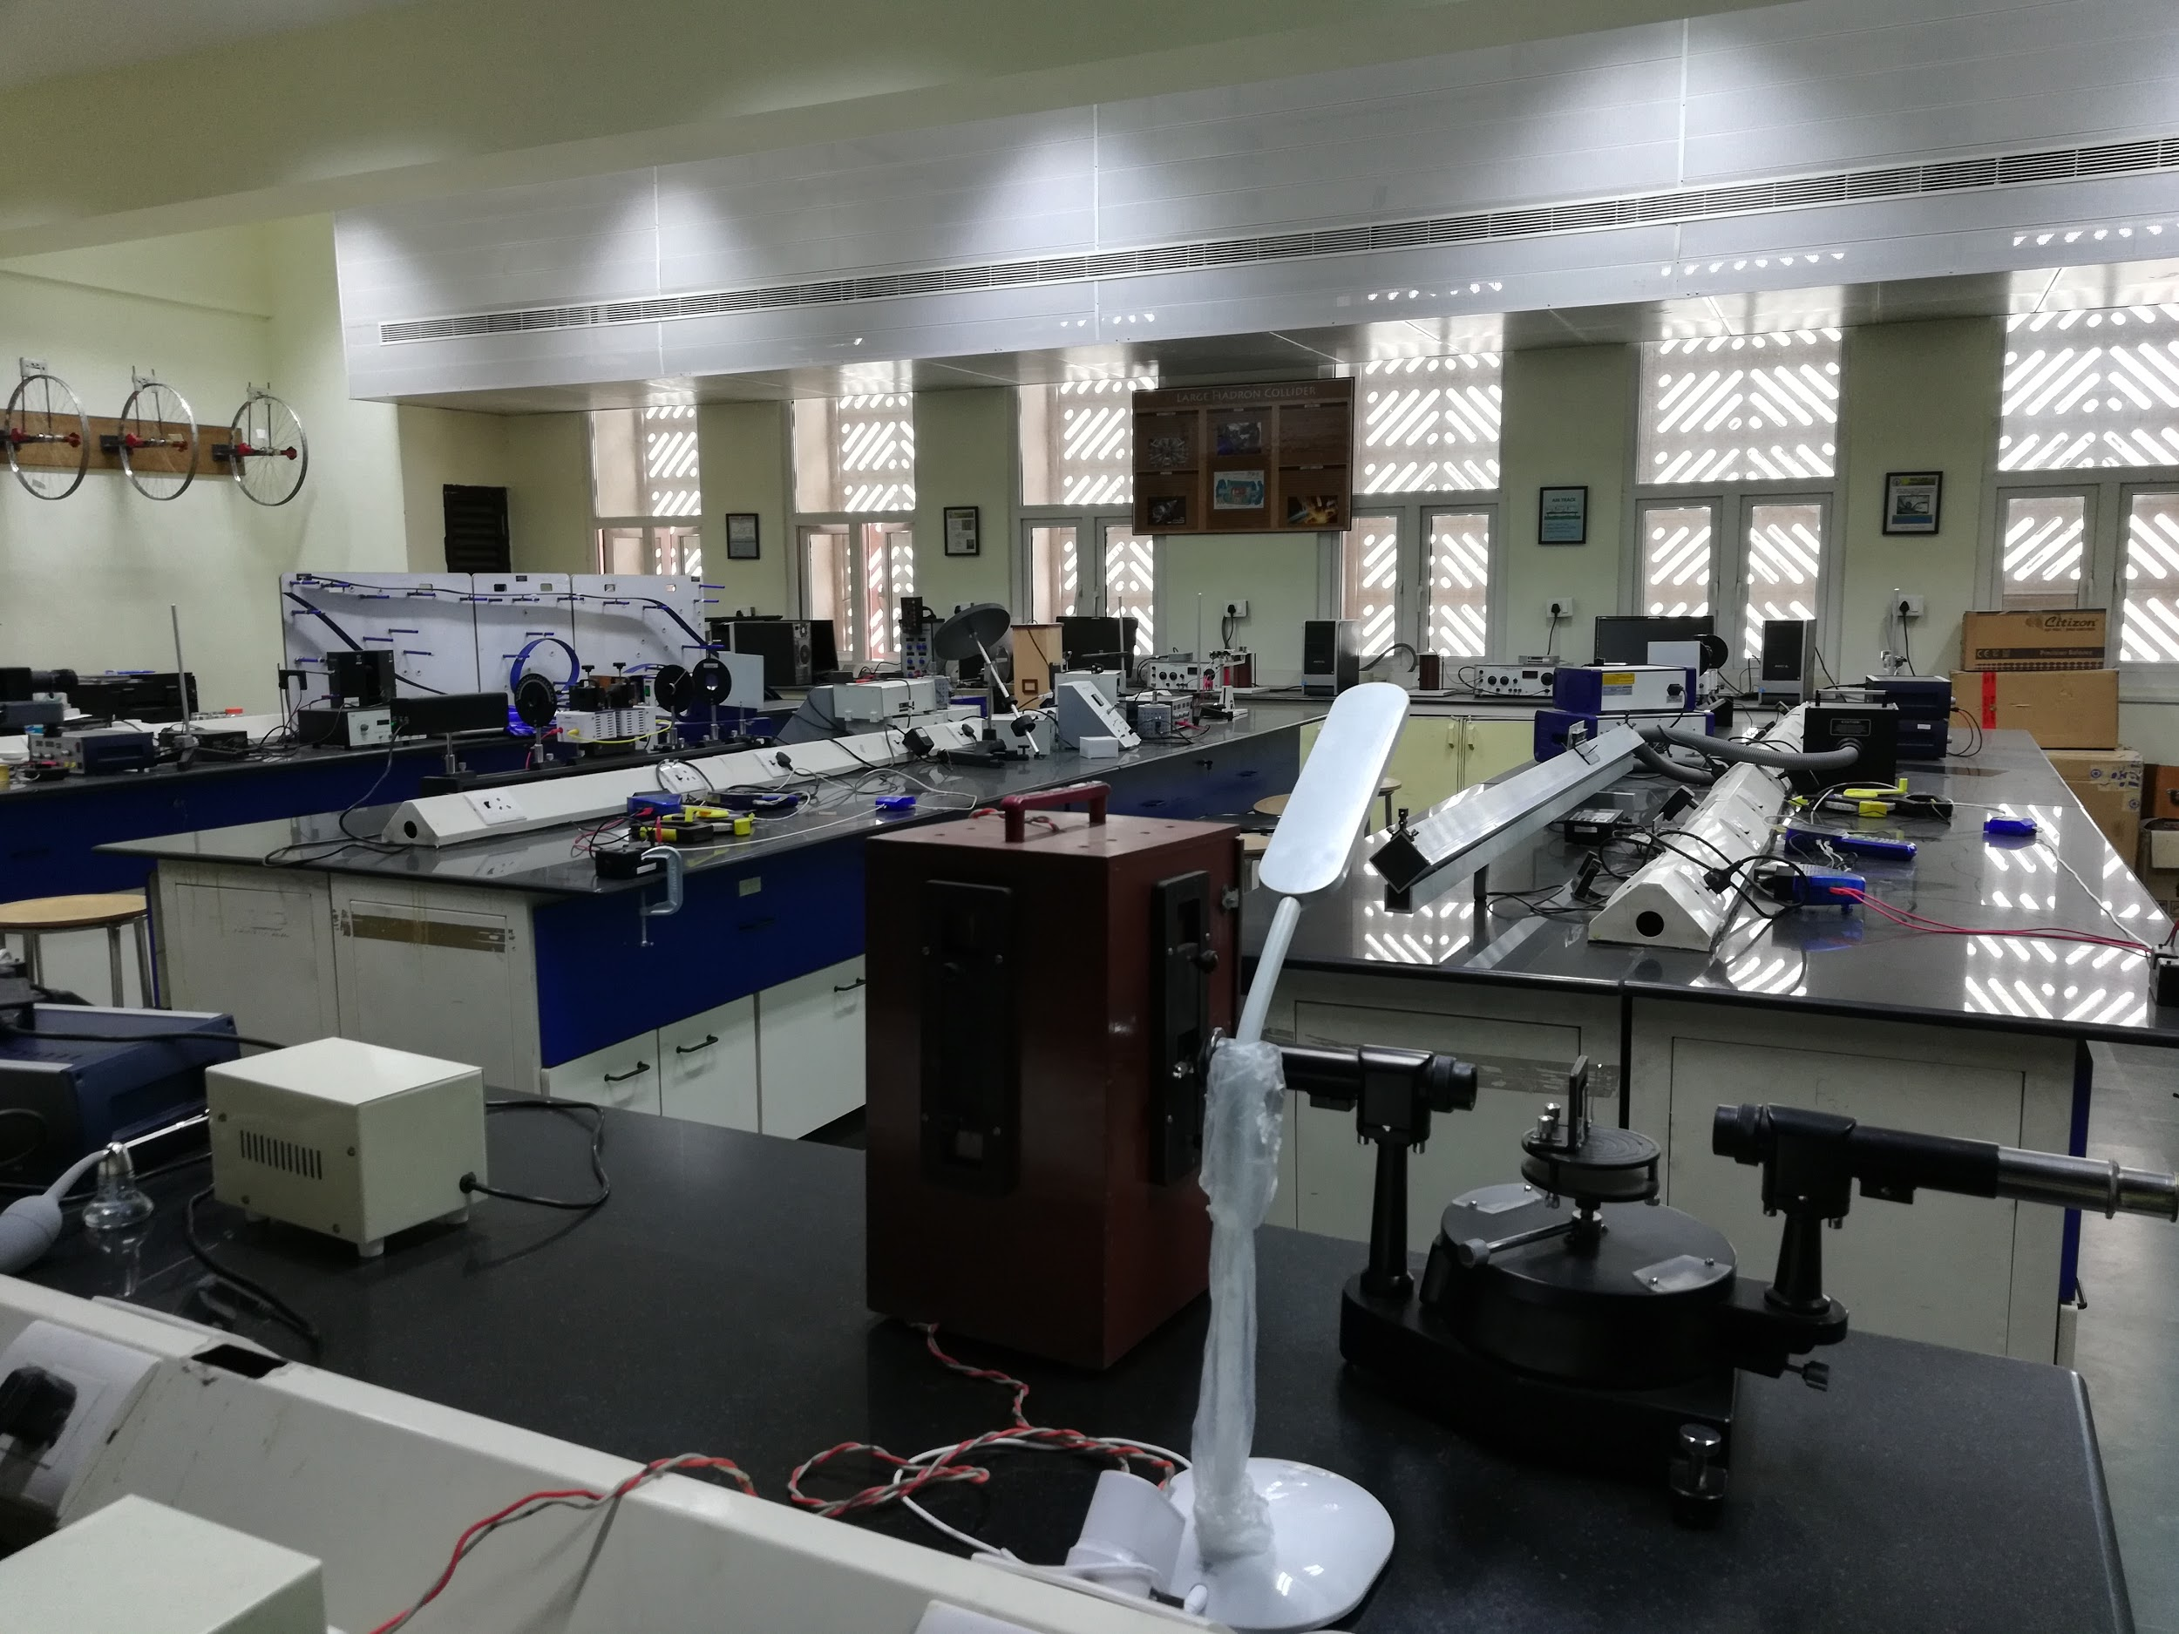
Venue: Basic Labs (Physics, IInd Floor)
In front of Computer Science Engineering Building
Students learn the systematics of performing experiments including setting up experiments, proper recording of observations, performing calculations, analysing the results vis-a-vis principles of physics, and possible error sources. Approximately 8 experiments will be performed by each student during the session.
Documentation –quite important.

Slide 5
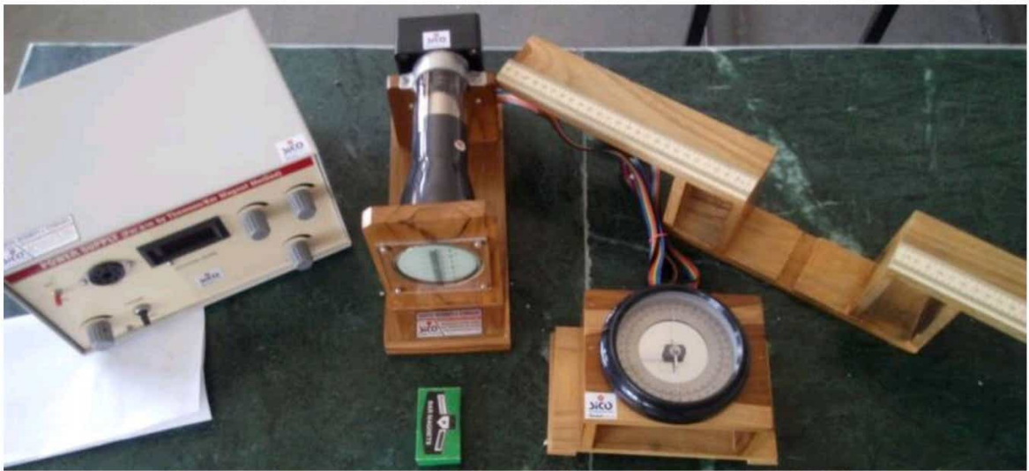
List of Experiments
1. e/m Ratio : To measure the specific charge, i.e., charge-to-mass ratio (e/m) of the electron using THOMSON’S METHOD
Electromagnetism
e/m Ratio Exp. Set-up

Slide 6
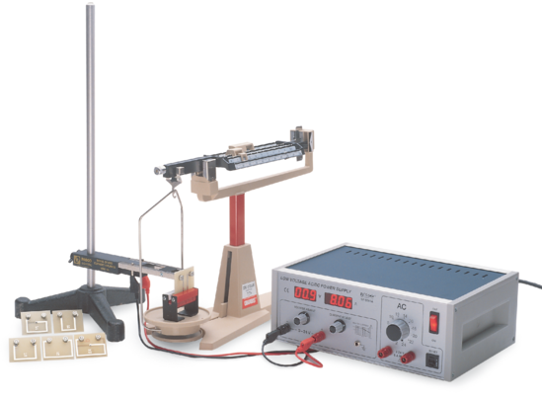
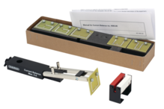
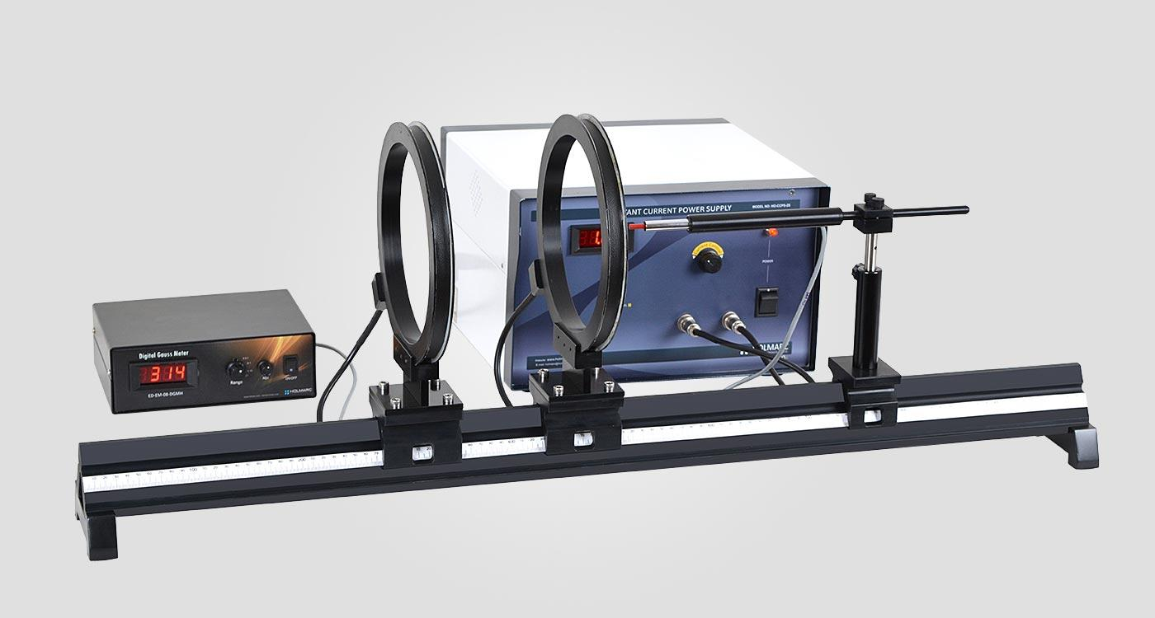
Electromagnetism
2. Basic Current Balance : Study of Effect of Magnetic field on a current carrying Conductor.
Basic Current Balance Exp Set-up
3. Biot-Savart’s Law Experiment : Measuring the magnetic field of circular conductor loops as function of the loop radius and distance from the loop
Biot-Savart’s Law Experiment

Slide 7
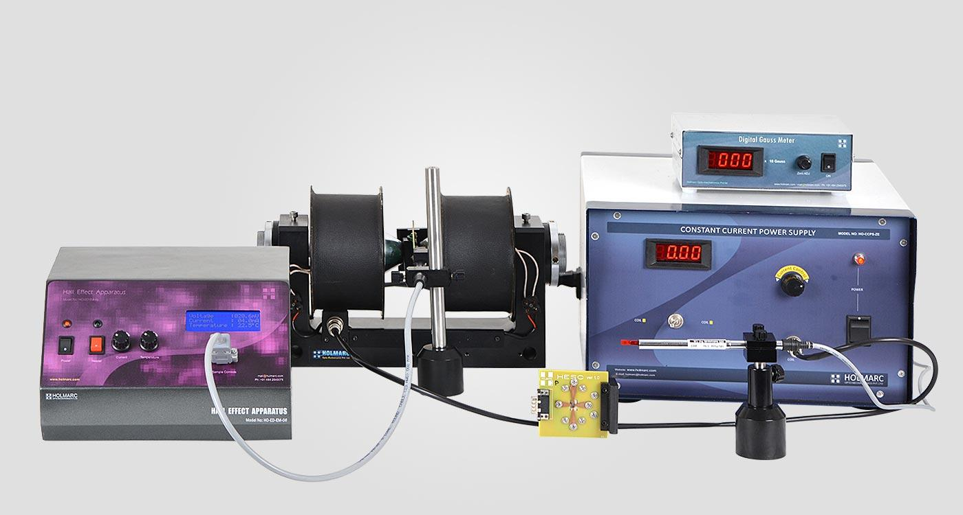
Intrinsic magnetic properties
4. Hall Effect : To study the Hall Effect in an extrinsic semiconducting sample and to determine the Hall voltage and Hall coefficient.
Hall Effect Exp. Set-up

Slide 8
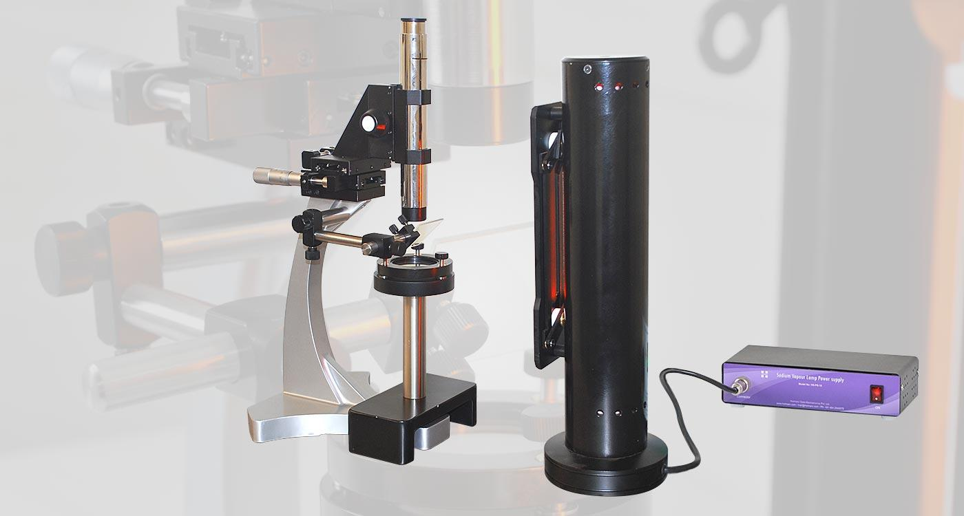
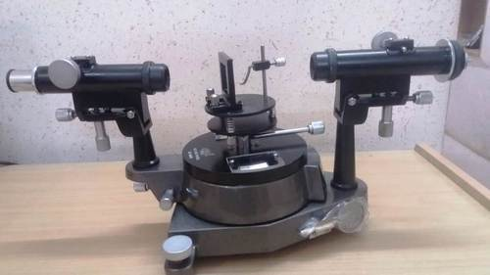
Wave nature of light
5. Newton’s Rings : Determining wavelength of Sodium light using Newton Ring’s, the interference fringes.
6. Diffraction Gratings : Determine the wavelength of prominent spectral lines of mercury light using a plane diffraction grating and spectrometer.
Newton’s Rings Exp. Set-up
Diffraction Gratings Exp. Set-up

Slide 9
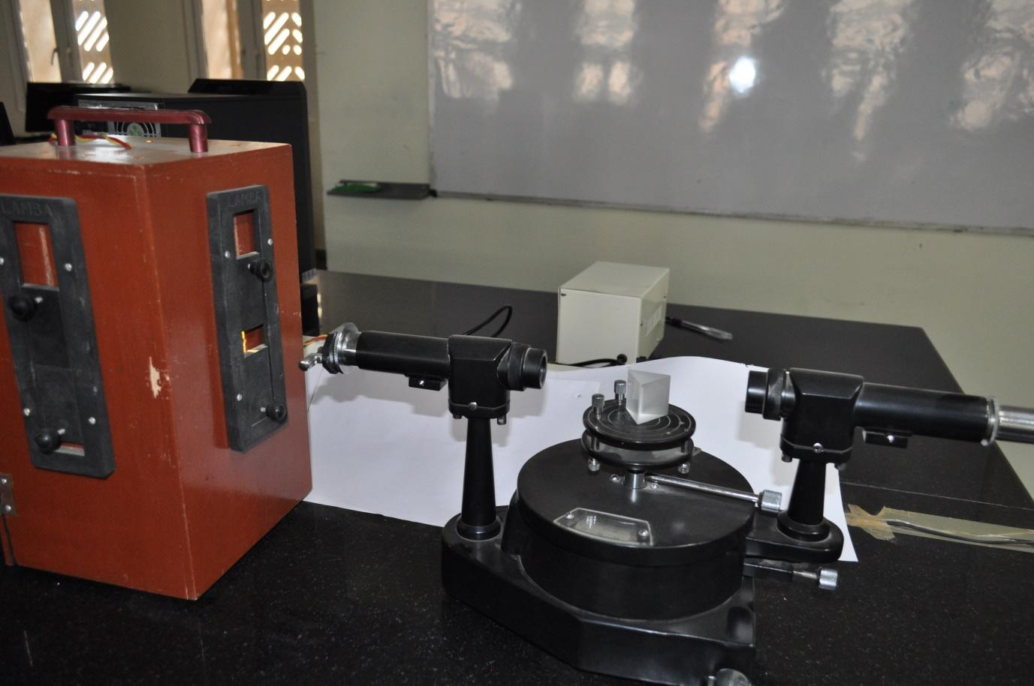
Wave nature of light
7. Disperisve Power : To determine the refractive index of prism material for particular prominent spectral lines of mercury light.
Dispersive Power Exp. Set-up

Slide 10
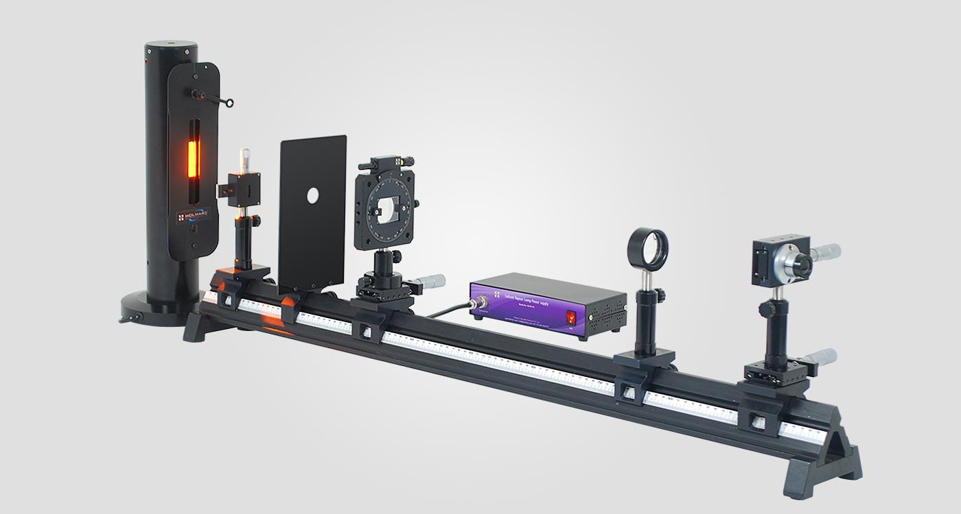
Wave nature of light
8. Young’s double slit experiment : Determine the wavelength of a monochromatic light source using Fresnel’s Biprism
Young’s double slit experimental Set-up

Slide 11
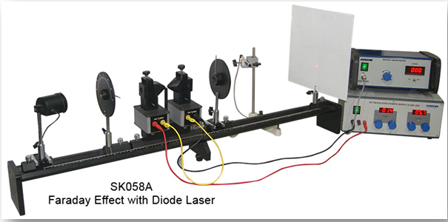
Magneto Optic
9. Faraday Effect : Observe the rotation of the plane-polarized light through flint glass or crystal when it is subjected to an external magnetic field.

Slide 12
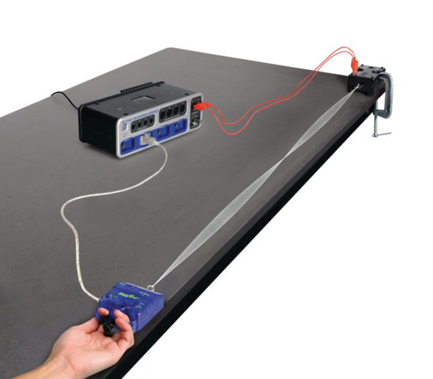
Mechanics
10. Stationary Waves in Strings : To understand the concept of standing wave and to determine the wave speed in a stretched vibrating string.
11. Flywheel : Determining the moment of inertia of a Flywheel.
Flywheel Exp. Set-up
Stationary Waves in Strings Exp. Set-up

Slide 13
Evaluation Process
Laboratory Work: 50 % (Continuous evaluation)
Prerecord preparation : weightage 10%
[Prerecord (before the class) should contain, Aim, Apparatus Required, Working Principle and Formula Used, Observation table (without readings )]
Assessment Part by respective TA’s: weightage 20%
Observational reading will be checked and signed by respective TA’s (how well the students conduct experiments)(weightage 10%)
Completed experiment with calculation, conclusion and precautions checked by respective TA’s on next lab session after the experiment : Weightage 10% (Late submission lead to penalty as to be decided by the respective instructor)
Completed record sheets assessment by the instructor during laboratory work (How the students are getting involved in the experiments): weightage 20%
Viva voce (During Lab Sessions by the faculty instructors) :20 %
Final Exam: 30%
Final Exam (Lab Experiment Work) :weightage 20%
Final Exam (Viva- Voce) :weightage 10%

Slide 14
Instructions for Students
Attendance
You must attend each laboratory class and do the assigned experiment. In general, you will not be permitted to do your experiments in another day / class. An exception may be made only in cases of dire necessity with the prior approval of the instructors of the assigned group and of the group in which you would like to do the experiment.
Preparation
Before each laboratory you are expected to read the write-up from the laboratory manual and any related sections of the text so that you are familiar with the theory and the experimental procedure. As it is often impossible to have the laboratory come after the relevant material has been discussed in lecture, you will often have to read ahead in your textbook. If the write-up has pre-lab questions, those must be understood before coming to the laboratory for performing the experiments.
Partners
Generally, you will work with one more partner. When necessary, groups of three may be permitted. Rotate the experimental tasks so that each partner becomes familiar with all aspects of the experiments, e.g., do not have one partner take all the data while the other does all the recording or analysis.
Data Sheets
Each partner must have his or her own data sheets for Lab reports. All necessary data should be on these data sheets. All data (single item and tabulated) should be clearly labeled with a description of the number and its units, and when appropriate, its uncertainty. The first data sheet will be provided in the physics lab.
In the Lab reports, it is expected that students must come prepared prerecord within a record file having the following information for each experiment on the day of the experiment;
(1) Objective/Aim (2)Apparatus Required (3)Theory with diagram & Formula used (4) Observation Table (Blank)
The following will be done during the lab sessions;
(5). Observation readings (6). Calculations (7). Error Analysis (8) Result (9) Precautions
(10) Graphs, when appropriate, should include a title, and axis labels with units.

Slide 15
Instructions for TAs
One of the TAs will take attendance and submit it to the lab Technical Staff on the day of experiment for record keeping.
Respective TAs will check prerecord preparation by the students assigned to them and will pass this information to the faculty instructor also.
Respective TAs will provide the accessories of the experiments (if any) to the students from the physics lab and will also collect and place these at the assigned place after the end of the lab session.
Respective TAs will help and guide students in performing the experiment during the lab sessions
Respective TA will see the observational readings of students, and will check and sign during the lab session of that particular day.
6). Respective TAs will assess for each experiment (how well the students conducted experiments) and provide their marks to the faculty Instructor during the lab session of that particular day.
7). Respective TAs will check the completed record submitted by the students and inform the respective instructors for further evaluation.
8). Respective TAs will participate enthusiastically and help in conducting smooth end-semester Exam.
9). The selected two TAs from each day session will help in preparing the final result with the faculty lab coordinator.

Slide 16
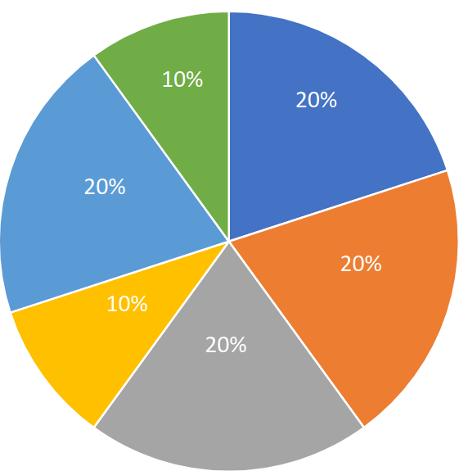
Grand Scheme of Evaluation
Prerecord preparation to be assessed by TAs for each experiment
Assessment & Observational reading checking by TAs for each experiment
100
8%
8%
8%
Completed record sheets assessed by Instructor
End Sem Exam
(20 % for Lab experiment Work)
16%
8%
End Sem Exam
(10% for final viva)
Viva-Voice by two Faculties during lab sessions

Slide 17
Thanks

